Slide 1
ECG Analysis through Deep Learning and IoT Devices
Paul Lussier
Advisor: Prof. Chen-Hsiang (Jones) Yu, Ph.D.

Slide 2
Introduction
Issues with current electrocardiogram collection and analysis
Patients don’t want to go in for Electrocardiogram
Deep Learning solutions - Convolutional Neural Networks (CNN)
Internet of Things
Noise reduction

Slide 3
Related Work
Remote Heart Monitoring - ECG Analysis using IoT devices and Machine Learning - Shrestha et. al. [1]
PhysioNet [2]
PhysioBank
PhysioToolkit
Yoon et. al. [3] discuss the integrity of some data points in the PhysioBank datasets being used
Avanzato et. al. [4] found that with convolutional neural networks(CNN) they were able to achieve 98.33% accuracy classifying different ECG rhythms
Chatterjee et. al [5] describe various noise reduction algorithms for electrocardiograms as well as some interesting ways of evaluating each method

Slide 4
Hypothesis
Can deep learning models be employed to classify ECG rhythms better than classical machine learning?
Can a deep learning model be trained using PhysioBank data and outperform traditional machine learning trained off of the same data?
Can a Raspberry Pi be used to create a mobile system to collect and classify the rhythm entirely on device?
Can we successfully read an ECG using IoT devices and get a clear enough signal to predict its rhythm using the deep learning model from above?

Slide 5
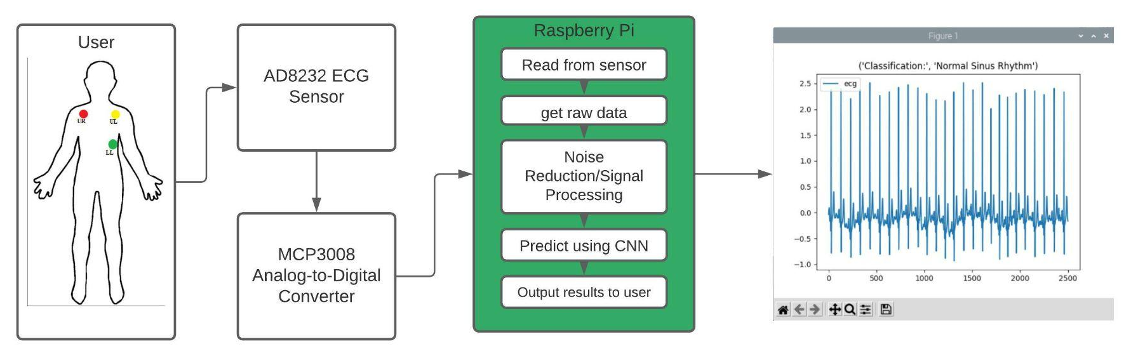
Design
High level pipeline flowchart

Slide 6
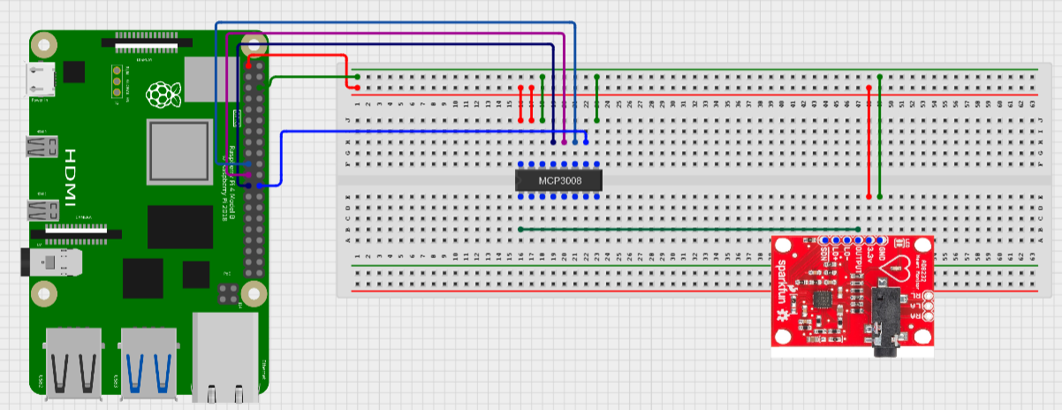
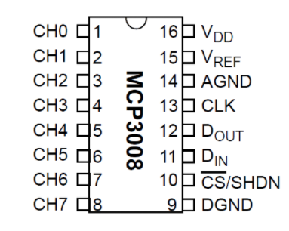
Design - Hardware
AD8232 ECG monitor[6]
MCP308 ADC[7]
Raspberry Pi

Slide 7
Design - Software
ecgTools
Data Extraction
Get data from a text file
Get data directly from PhysioBank
Data Collection
Run the AD8232 and record its outputs into a text file for later analysis
Data Preprocessing
Reshape data to fit the parameters set by the model
Post-processing and Noise Reduction
Simple Moving Average (SMA), Exponential Moving Average (EMA), Highpass, and Fast Fourier Transformation (FFT) filter implementations
Visualization and Output
Plotting functions
Function to query the model and return its classification of a signal

Slide 8
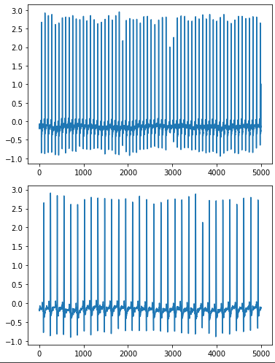
Implementation
Training Data Extraction and Preprocessing
Google colab
Resampling
(128 samples/second --> 250 samples/second)
Condensing into a single random set
Train-Test split

Slide 9
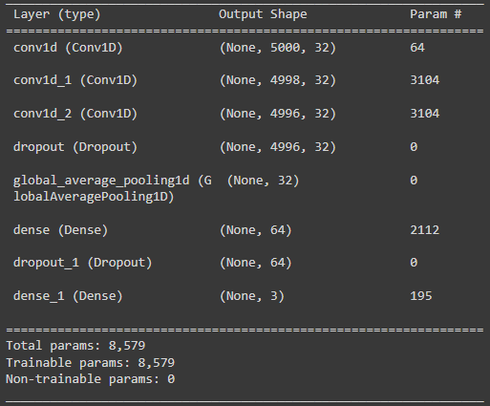

Implementation
Training the Model
Custom CNN layer structure
First 10 epochs

Slide 10
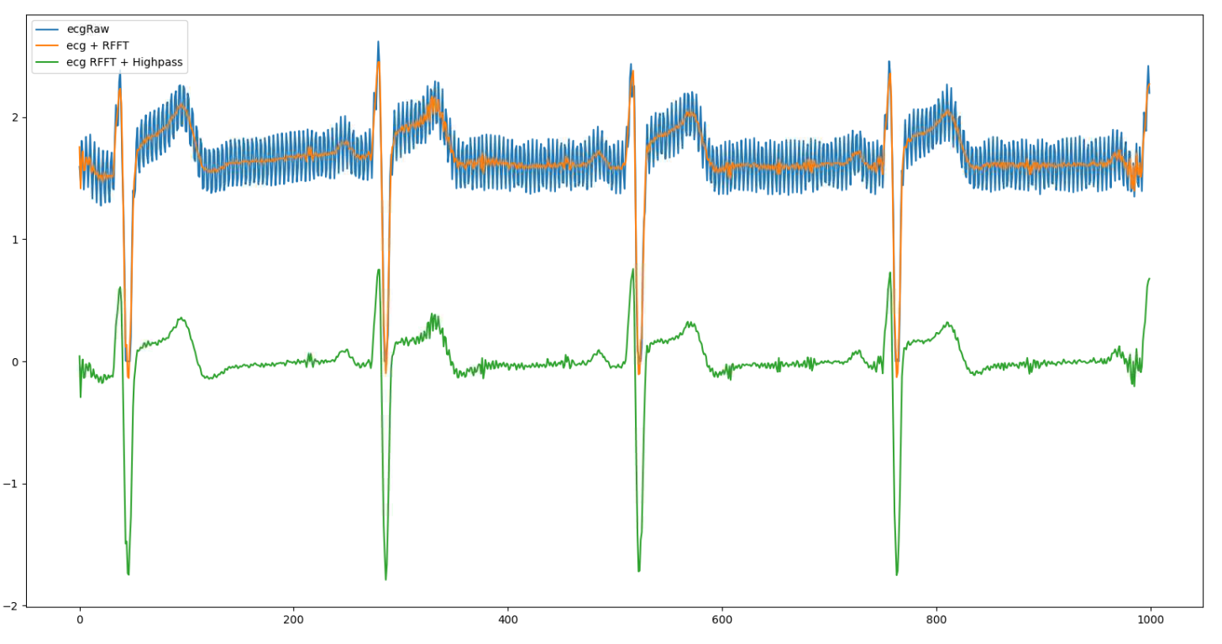
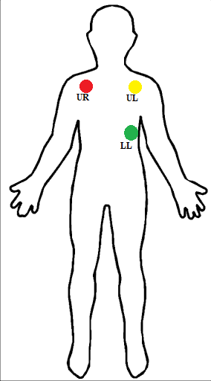
Implementation
Data Collection
Postprocessing and Noise Reduction

Slide 11
Evaluation
96.93%
Accuracy when trained on segments with a length of 5000 and tested on the set aside testing split
Classical machine learning models score up to 85% when evaluated in the same manor[1]

Slide 12
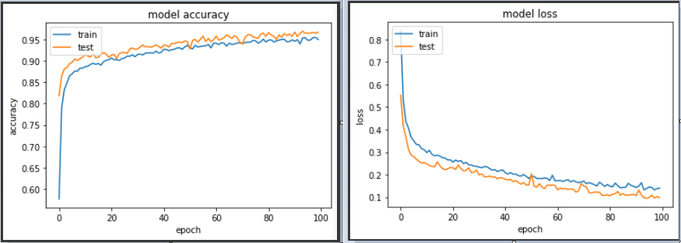
Evaluation
Model accuracy and loss over 100 epochs

Slide 13
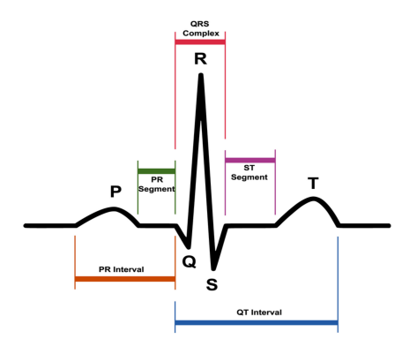
Discussion
Raw IoT ECG data from AD8232 has lots of noise centered at 63Hz
Need for wider experimentation with users with all three heart rhythms
No way of confirming how it is classifying (P and T wave analysis)
Should we want to classify with “traditional” methods?

Slide 14
Contributions
Creation of a python library for easy ECG analysis
Portable device capable of holding and querying a Convolutional Neural Network
Successful noise reduction of IoT data from an unreadable signal to one that can be easily classified by the human eye and had equal fidelity to hospital grade machines

Slide 15
Conclusions
Deep learning seems to be capable of more accurate models for classifying ECG rhythms
As long as a Convolutional Neural Network is trained on a more powerful system it can be loaded onto an IoT device and deployed into the field for fully local classification.

Slide 16
Future Work
We would like to gather more data to determine the true accuracy of our model when classifying data from the AD8232 or implement another sensor specifically built for ECG recording in non-ideal conditions
Chatterjee et. al [5] have described ways of evaluating performance of noise reduction on ECG data that we did not have time to implement so we would like to explore their findings
Look into other ways of evaluating noise reduction algorithms - Hagerman and Olofssonn’s phase inversion technique [8] has some success in determining the effectiveness of noise reduction algorithms in hearing aids

Slide 17
References
Goldberger, A., Amaral, L., Glass, L., Hausdorff, J., Ivanov, P. C., Mark, R., ... & Stanley, H. E. (2000). PhysioBank, PhysioToolkit, and PhysioNet: Components of a new research resource for complex physiologic signals. Circulation [Online]. 101 (23), pp. E215–e220.
Shrestha, A., Yu, J., (2021). Remote Heart Monitoring - ECG data analysis using IoT Devices and Machine Learning.
K. H. Yoon et al., "Analysis of Statistical Methods for Automatic Detection of Congestive Heart Failure and Atrial Fibrillation with Short RR Interval Time Series," 2015 9th International Conference on Innovative Mobile and Internet Services in Ubiquitous Computing, 2015, pp. 452-457, doi: 10.1109/IMIS.2015.88.
Avanzato R, Beritelli F. Automatic ECG Diagnosis Using Convolutional Neural Network. Electronics. 2020; 9(6):951. https://doi.org/10.3390/electronics9060951
Chatterjee, S., Thakur, R.S., Yadav, R.N., Gupta, L. and Raghuvanshi, D.K. (2020), Review of noise removal techniques in ECG signals. IET Signal Process., 14: 569-590. https://doi.org/10.1049/iet-spr.2020.0104
AD8232, S., (2021). SparkFun Single Lead Heart Rate Monitor - AD8232 - SEN-12650 - SparkFun Electronics. [online] Sparkfun.com. Available at: <https://www.sparkfun.com/products/12650>
MCP3008, A., (2021). Adafdruit 8 channel 10-bit ADC with SPI interface - MCP3008 - Adafruit. [online] Adafruit.com. Available at: <https://www.adafruit.com/product/856>
Hagerman, Björn & Olofsson, Åke. (2004). A Method to Measure the Effect of Noise Reduction Algorithms Using Simultaneous Speech and Noise. Acta Acustica united with Acustica. 90. 356-361.

